Slide 1
Everything’s An Argument
AP Lang and Comp: Snell

Slide 2
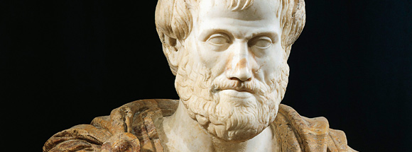
The Three Appeals
The Greek philosopher Aristotle was interested in how people won agreement. He divided techniques of persuasion into three categories:
Ethos
Pathos
Logos

Slide 3
Ethos (Ethical Appeal)
Ethos is all about credibility. We believe people we respect have behaved ethically. A rhetorician may appeal to ethos if he/she is credible or perhaps attack an opponent’s credibility.

Slide 4
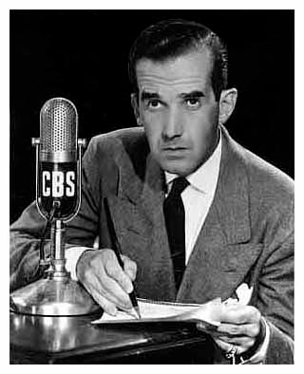
The Importance of Ethos
“To be persuasive we must be believable; to be believable we must be credible; to be credible we must be truthful. It is as simple as that.”
--Edward R. Murrow

Slide 5
Ethos is established through:
Education
Experience
Professional Reputation
Character
Attacking an opponent’s reputation is making an appeal to ethos as well.
(Often this is a weak argument. There is a logical fallacy called ad hominem.)

Slide 6
Ethos: Citing Experts
Another way a rhetorician can establish credibility is to cite sources. The rhetorician appears well-read.
You’ll see cited sources establishing credibility in everything from medical journals to history museums to HIGH SCHOOL RESEARCH PAPERS.

Slide 7
Ethos: Relatability
Rhetoricians can appeal to ethos by establishing relatability.
Often, powerful people will want an audience to relate to them as an “everyman.”
In an election year you will often hear phrases like:
“Fourth generation Minnesotan”
“Raised my family in Minnesota”
“I’ve lived in Minnesota my entire life”

Slide 8
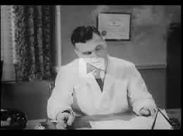
Ethos Television Ad
Watch this television ad from 1949.
How do the ad’s creators appeal to ethos for their audience in 1949?
How do we view this ad differently in 2014?
Click here for to play video.

Slide 9
Ethos Review
Again, an appeal to ethos is an argument that depends upon the rhetorician’s credibility. The more we trust someone, the more likely we are to believe what they say is true.
PLEASE NOTE:
Incorrect: Aristotle uses ethos
Correct: Aristotle appeals to ethos
Also Correct: Aristotle’s appeal to ethos

Slide 10
Pathos (Emotional Appeal)
An appeal to pathos persuades people by appealing to their emotions.
Pathos shares the same root as:
Sympathetic
Empathic
Pathetic
This family of words refers to shared feelings and suffering.

Slide 11
Pathos: Tugging Heart Strings
Sometimes appeals to pathos are intended to make an audience feel:
Sadness
Pity
Guilt
Compassion

Slide 12
Pathos: Other Objectives
Love
Joy
Pride
Greed
Desire
Fear
Anger
Disgust

Slide 13
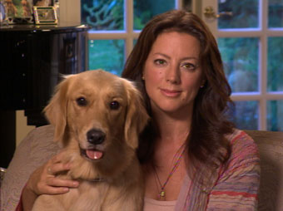
Pathos Television Ad
What emotions are evoked by the first 30 seconds of the commercial?
What does the rhetorician want the audience to do?
Click here for to play video.

Slide 14
Effectiveness
This ad raised well over $30 million dollars for the American Society for the Prevention of Cruelty to Animals.
It was so effective because it provided a one-two punch to audiences: make them feel terribly sad and then provide them with a way to alleviate that sadness.

Slide 15
Pathos Review
Again, an appeal to pathos is designed to get an audience to feel the same emotions as the rhetorician.
The most commonly invoked emotions include sympathy, anger, and fear.

Slide 16
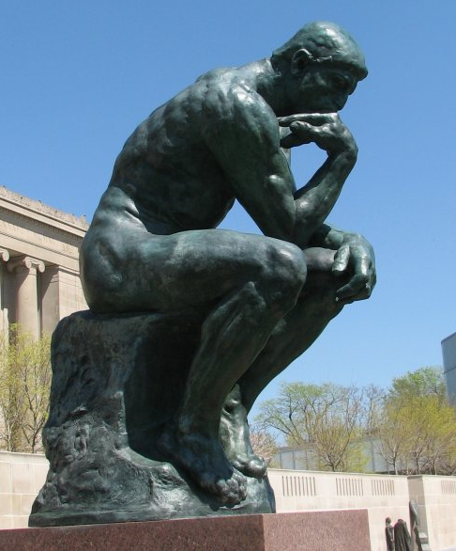
Logos (Logical Appeal)
An appeal to logos persuades people through the use of logic.
Facts Valid Points Inferences | Step-by-Step A+B=C Analogies

Slide 17
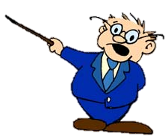
Spotting an Appeal to Logos
1. Are their arguments based on definition?
What does a term mean?
What is the essential nature of something? i.e. freedom.
What features does something have?
2. Does the rhetorician make analogies or comparisons?
3. Are there appeals to cause and consequences?
4. Does the rhetorician rely on testimony or authority by citing the received opinions of experts?

Slide 18
Logos: Citing Experts
Another visit from our favorite rhetorical superhero!
Citing credible sources probably best fits under the umbrella of Logos.

Slide 19
Logos Video Ad
What strategies do the rhetoricians use to appeal to logos?
How do visual elements of the video emphasize the use of logic?
Click here for to play video.
Start at 8:19 minute mark.

Slide 20
Logos Review
Again, an appeal to logos is designed to get an audience to make sense of the situation.
The most commonly used are analogies, step-by-step patterns,
syllogisms, and examples.

Slide 21
Jolliffe’s Framework

Slide 22
Exigence
An exigence is a pressing problem in the world, something to which people must attend.
An exigence, [Lloyd] Bitzer (1968) asserted, is 'an imperfection marked by urgency; it is a defect, an obstacle, something waiting to be done, a thing which is other than it should be.

Slide 23
Exigence
Exigence has to do with what prompts the author to write in the first place,
a sense of urgency
a problem that requires attention right now
a need that must be met,
a concept that must be understood before the audience can move to a next step
(M. Jimmie Killingsworth, Appeals in Modern Rhetoric. SIU, 2005)

Slide 24
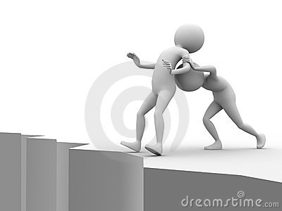
Exigence
Exigence is sometimes compared to an outside force pushing a rhetor to write about the topic.
Ask: What pushed the speaker write the piece or deliver this speech?

Slide 25
Audience
The readers of listeners imagined by a writer or speaker before and during the composition of a text.

Slide 26
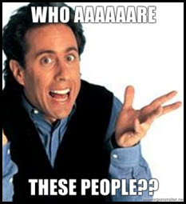
Audience: Who are these people?
A rhetorician can increase awareness of an audience by considering a few questions.
Who are to be your readers?
What is their age level? background? education?
Where do they live?
What are their beliefs and attitudes?
What interests them?
What, if anything, sets them apart from other people?
How familiar are they with your subject?
(X.J. Kennedy, et al., The Bedford Reader, 1997)

Slide 27
Audience
Knowing your audience means understanding what it is that they want to know, what they are interested in, whether they agree with or oppose your central arguments, and whether they are likely to find your subject matter useful. --David E. Gray
Even the way you organize your writing and the amount of details you include (the terms you define, the amount of context you provide, the level of your explanations) depends in part on what your audience needs to know.”
-- Scribner's Handbook for Writers

Slide 28
Purpose
If an exigence is a force that pushes a rhetorician into composing a piece.
Think of purpose as the force pulling a writer through the composition.

Slide 29
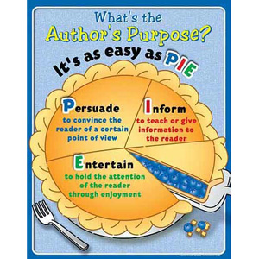
Author’s Purpose
To persuade
To inform
To entertain
-----------------------
To describe
To inspire

Slide 30
Author’s Purpose
Informative | Persuasive
to inform | to persuade
to describe | to convince
to define | to influence
to review | to argue
to notify | to recommend
to instruct | to change
to advise | to advocate
to announce | to urge
to explain | to defend
to demonstrate | to justify
to illustrate | to support

Slide 31
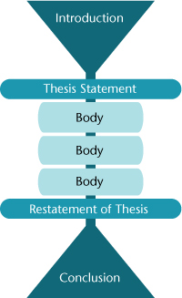
Organization
Organization refers to how the text is put together.
People will often refer to this as a text’s “structure” or “form”
Organizational Structures
Chronological
Compare and Contrast
Order of Importance
Sequence
Spatial
Cause and Effect
Problem and Solution

Slide 32
Diction
Diction can be defined as “the choice of words.” Diction is effective when chosen words are appropriate for an audience.
“Ride” “Wheels” “Car” “Automobile” “Motor Car”

Slide 33
Diction
Sometimes diction is described in terms of four levels of language:
formal, as in serious discourse
informal, as in relaxed but polite conversation
(3) colloquial, as in everyday usage
(4) slang, as in impolite and newly coined words.
It is generally agreed that the qualities of proper diction are appropriateness, correctness, and accuracy.
Hey girl, is this too formal?

Slide 34
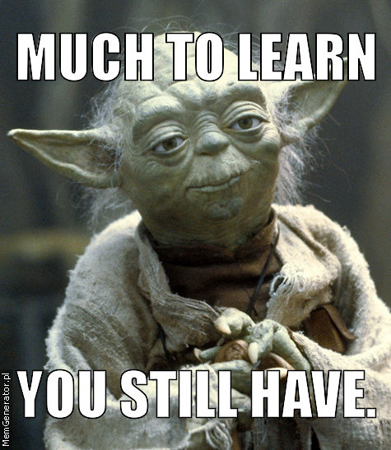
Syntax
Syntax is primarily concerned with the ways in which words are put together in sentences.
Syntax is a word which comes from the Greeks. It means, in that language, the joining of several things together.
Click here for Yoda-speak generator.

Slide 35
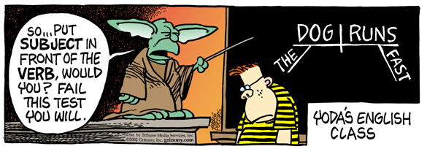
Yoda as Student & Teacher

Slide 36
Key Syntax Questions:
How does syntax contribute to and enhance the meaning and effect of language?
How does syntax contribute to tone?
Syntax
Meaning
Tone

Slide 37
Syntactical Strategies
Among others, Authors may use:
specific patterns of phrases and sentences
divisions within a piece with different syntax for each
parallel structure
different sentence types
specific kinds of punctuation

Slide 38
Studying Syntax
Make observations about the content and syntax of each sentence or group of sentences. Look for elements listed above or others observed.
Does the sentence length fit the subject matter?
Why is the sentence length effective?
What variety of sentence lengths is present?
Sentence beginnings – Variety or Pattern?
Arrangement of ideas in sentences
Arrangement of ideas in paragraph – Pattern?

Slide 39
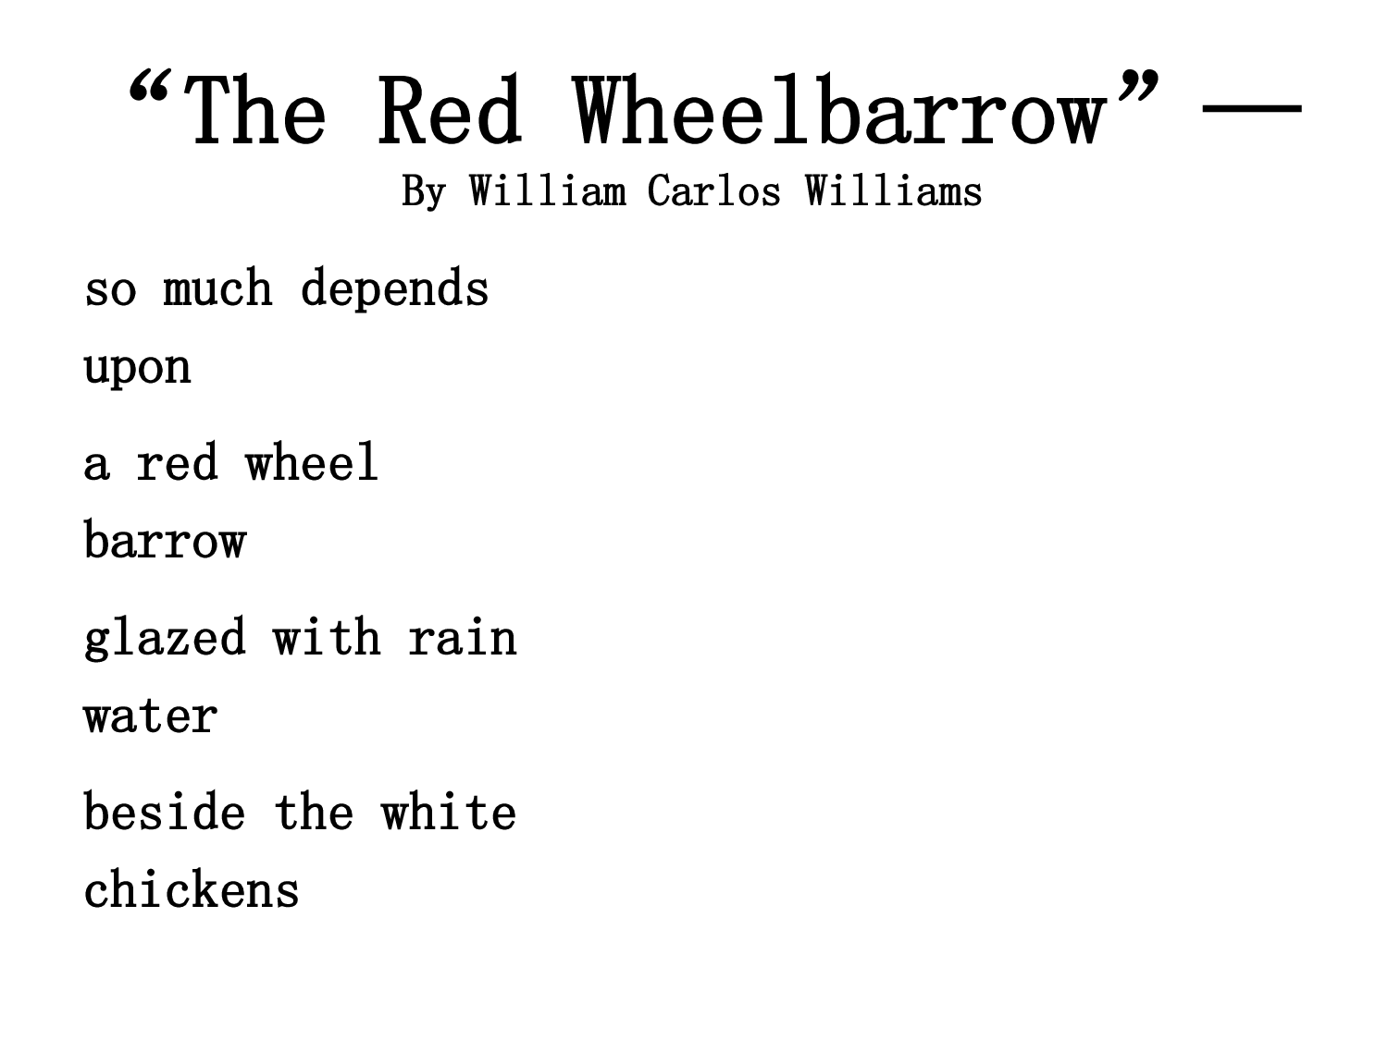
Imagery
Imagery: The use of words and phrases that appeal to the five senses that are: touch, smell, hear, feel and taste

Slide 40
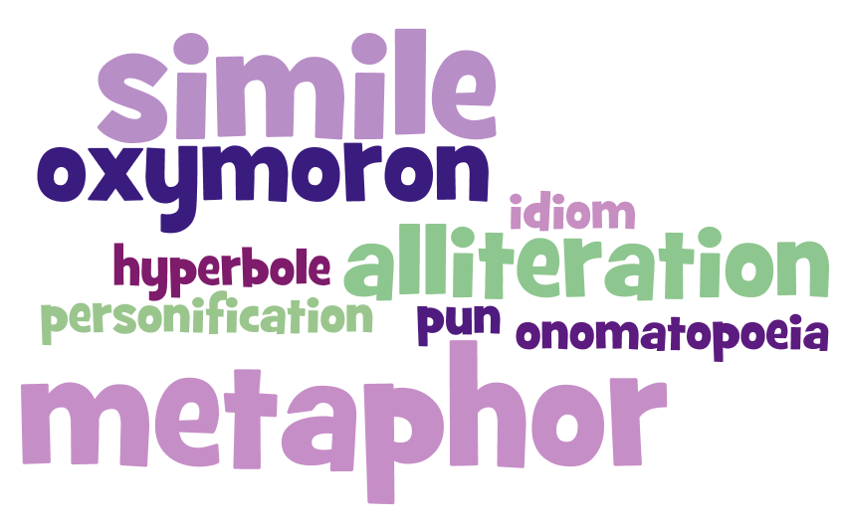
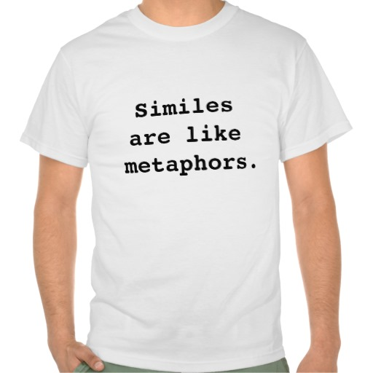
Figurative Language

